Slide 1
Proposed Workshop Plan

Slide 2
Overall Aim
To improve research participation and engagement of the local community that is reflective of its diversity through system-level ‘partnerships’ (i.e. ICS, CRN, UCLP, AHSN, Voluntary Sector)

Slide 3
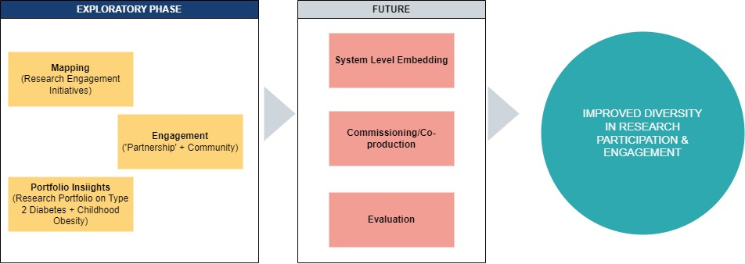

Slide 4
Workshop Proposals
Original Proposal: Present REI and Opportunities for Upscaling
Other proposals:
  ‘Simple questions’ leading to Collaboration with local community on Diabetes and Childhood Obesity
  Citizens’ Research Forum

Slide 5
Workshop Plan
What: (see next slides for sample workshop)
Who: ‘Multi-stakeholders’
  Parents and young people (?)
  GP and primary care professionals
  Type 2 diabetes researchers/academics in the region
  Childhood obesity researchers/academics in the region
  Charity representatives on Type 2 diabetes/childhood obesity
  School nurses/head teachers in the region (?)
  Community Research Champions
When: 2nd Week of March 2023
Where: 2 of the suggested Locations
  Stratford
  Newham Old Library
  CVS in Barking
How: Workshop Format (Presentation + Facilitated Discussion)

Slide 6
Sample WP 1: Collaboration with Local Community
Objectives:
Present an example of research engagement initiatives (REI) on previous studies on type 2 diabetes and childhood obesity to the multi-stakeholder group
Facilitate a reflective discussion among the multi-stakeholder group ons
  Strengths of the sample REI
  Limitations of the sample REI
Develop a shared vision of what the future REI would look like

Slide 7
Sample WP 2: Citizens’ Research Forum
Objectives:
Present the importance of collaboration with the local community in developing research agenda
Present the need to develop research on childhood obesity and Type 2 diabetes within the region
Obtain the perspectives of the different stakeholders on the concept of research
Discuss within the group the future of research collaboration with the local community

Slide 8
Resources
Venue (Booking Cost)
Stipend/Travel for Participants (per participant)
Catering cost/ refreshments
Workshop materials + Workshop Packs
Professional Facilitator (if applicable)
CI/PI of Type 2 Diabetes study who did REI
CI/PI of Childhood Obesity study who did REI
£10,000 Allocated for the Workshop

Slide 9
Points for Discussion:
Is WP1 or WP2 fit-for-purpose of the overall project?
  If yes, which from the proposed plans (WP1 vs WP2) are we going forward?
  If no, what is the right workshop?
Identify accountable persons for the resource list.
Decide on timelines.

